Slide 1
Module 1 : Introduction to Flutter

Slide 2
Contents
Overview of Flutter
What is Flutter - Why Flutter
Flutter architecture ?
Dart Language Basics
Introduction to Dart and its role in Flutter
Development Environments
DartPad, VS Code, Android Studio
Setting Up Flutter
Installing SDK & Android Studio
Configuring Emulator
Creating & Running Your First App

Slide 3
What is Flutter?
Flutter is a UI toolkit developed by Google for building natively compiled apps from a single codebase.
Supports Android, iOS, Web, macOS, Linux, and Windows.
Written in Dart using its own rendering engine (Skia).
Enables rapid UI development through reusable widgets.

Slide 4
Why Flutter?
Feature | Description
Fast Development | Hot Reload / Hot Restart
Beautiful UI | Material & Cupertino widgets
Single Codebase | Write once → deploy everywhere
Performance | Nearly native speed

Slide 5
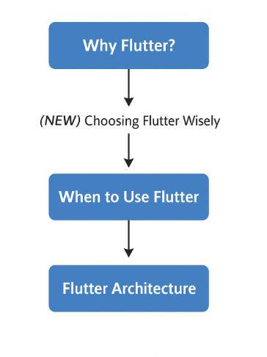
Choosing Flutter Wisely
From Features to Project Decisions
Flutter offers many powerful features
However, no technology fits all projects
Choosing the right tool depends on project context
Key message:
Understanding when to use Flutter is as important as knowing why Flutter is powerful.
Notes:
In the previous section, we found Flutter to be powerful in every respect.
Now, we move on to a more important practical question:
Should we use Flutter for this project?

Slide 6
When Is Flutter a Good Choice?
Cross-platform applications with shared UI and logic
MVPs, startups, and rapid prototyping
Business applications (e-commerce, booking, dashboards)
Apps with moderate use of device features
Teams with limited native Android/iOS resources
Flutter is most effective when the goal is time to market, reduced development costs, and maintaining a single codebase.
Notes:
Most enterprise applications don't need to be 100% native, and this is where Flutter is a great fit.

Slide 7
Flutter with Native Integration
Content:
Flutter handles UI and business logic
Native code handles platform-specific features
Communication via Platform Channels
Examples of native integration:
Camera, Bluetooth, NFC
Payment SDKs
OS-level services
Flutter doesn't eliminate native code, but integrates with it.
When Flutter doesn't directly support a feature,
we can write native Android code (Kotlin/Java)
or native iOS code (Swift) and connect via Platform Channels.
This is a very common model in real-world projects.

Slide 8
When Native Development Is Preferable
Applications requiring deep OS customization
High-performance games or real-time graphics
Very low-level hardware access
Strict platform-specific UI/UX requirements
Key takeaway:
Flutter is powerful, but not always the optimal choice.
Notes:
There are cases where the original approach is a more logical choice from the start,
For example, graphically intensive games, applications that require deep integration with the operating system, or applications that demand specific principles unique to Android or iOS.
The important thing is to choose the right tool for the right problem.

Slide 9
A Brief History
2015: Sky project.
2017: Flutter Alpha.
2018: Flutter 1.0.
2021: Flutter 2.0 adds Web/Desktop.
2023–2025: Flutter 3.x stable.

Slide 10
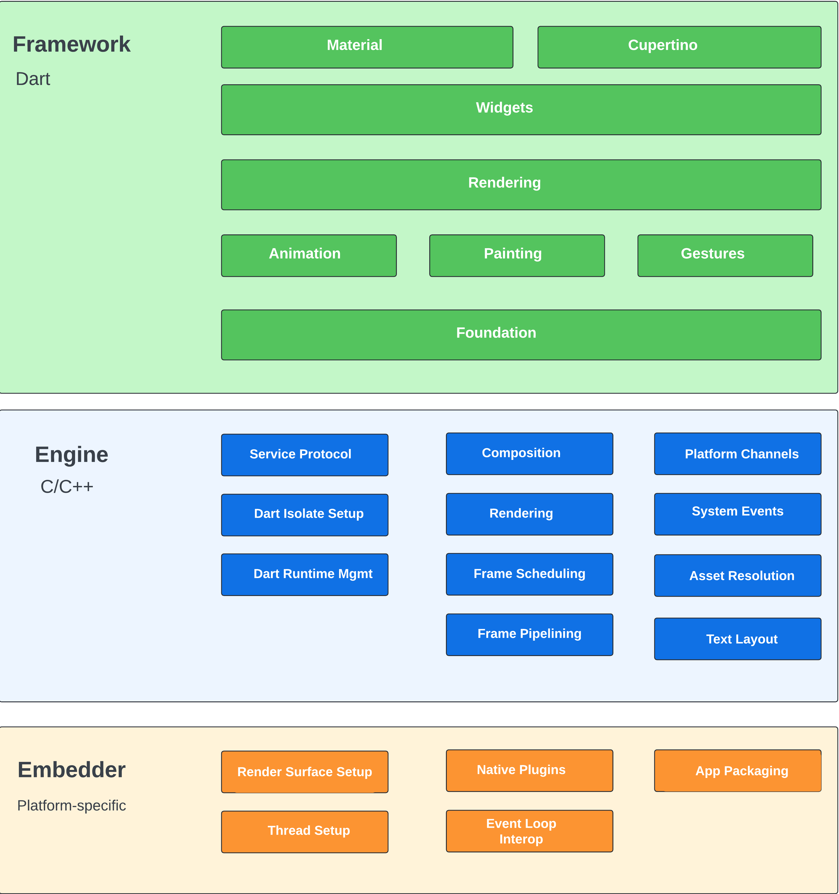
Flutter Architecture Overview
Three Layers:
1. Framework (Dart)
2. Engine (C++)
3. Embedder
Workflow: Widget Tree → Render Tree → Composited Scene → GPU Rendering

Slide 11
Framework Layer
Widgets (Stateless, Stateful)
Rendering and Layout system
Foundation libraries
Key concept: Everything in Flutter is a Widget.

Slide 12
Engine Layer - Embedder Layer
Engine Layer:
Embedder Layer:
Written in C++, powered by Skia.
Handles rendering, accessibility, text layout.
GPU acceleration ensures consistency.
Platform-specific integration.
Handles input, lifecycle, window management.
Custom embedders for Raspberry Pi.

Slide 13
Benefits of Flutter
Performance: Compiles to ARM code.
Consistency: Same UI across devices.
Flexibility: Rich widget set.
Flutter vs Others
Framework | Language | Output
Flutter | Dart | Native UI + Engine
React Native | JS | Bridges to Native
Native (Android/iOS) | Kotlin/Swift | Pure Native

Slide 14
Dart: Flutter’s Programming Language
Designed for UI creation.
Combines AOT and JIT compilation.
Supports null safety and strong typing.
Example:
void main() {
print('Welcome to Flutter!');
}

Slide 15
Dart Core Features
Object-Oriented.
Functions as first-class objects.
Null safety.
Async/Await.

Slide 16
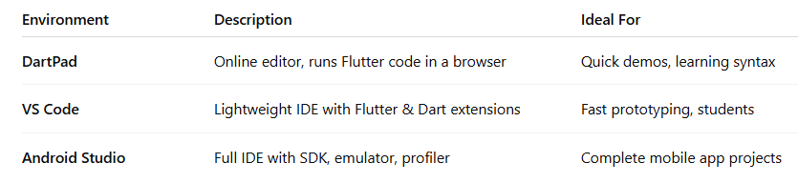
Flutter Development Environments Overview
Flutter can be developed in three main environments, depending on the learner’s goal and hardware setup:
Start students with DartPad → then move to VS Code / Android Studio.
Emphasize that all tools compile to the same Flutter runtime.

Slide 17
Using DartPad (Online Environment)
URL: https://dartpad.dev
Key Features
No installation required
Run Flutter code instantly in browser
Supports core widgets (Scaffold, Text, Column, etc.)
Ideal for live demo and exercises

Slide 18
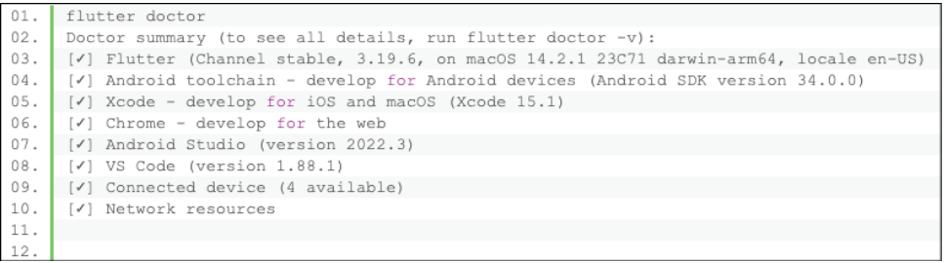
Installing the Flutter SDK
Download from flutter.dev
Extract the folder (e.g., C:\src\flutter or /Users/you/flutter)
Add Flutter to the system PATH
Verify installation:
Figure 1.2: Flutter doctor
Notes:
Notes
macOS users need Xcode for iOS builds.
Windows users should enable virtualization for emulator support.

Slide 19
Installing Android Studio
Purpose: Android Studio provides IDE, SDK tools, and emulator to build and run Flutter apps.
Steps:
Download and install Android Studio
Install Flutter Plugin
Go to Preferences → Plugins → Flutter
Dart plugin installs automatically
Note: Ensure Android SDK and command-line tools are installed.

Slide 20
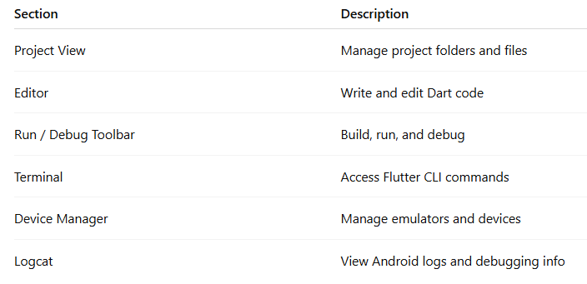
Android Studio Interface Overview

Slide 21
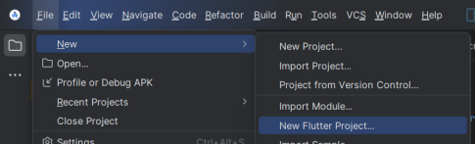
Create a New Flutter Project
Click File → New → New Flutter Project
Select Flutter SDK path
Enter project name: movies
Organization ID: com.fptu.movies
Choose platforms: ✅ Android ✅ iOS ✅ Web ✅ macOS ✅ Windows

Slide 22
Flutter Project Structure
Folder | Description
lib/ | Contains main Dart code
android/ | Android platform-specific code
ios/ | iOS platform-specific code
web/ | Web app files
pubspec.yaml | Dependencies and assets configuration
test/ | Unit test files
lib/main.dart is the app entry point.

Slide 23
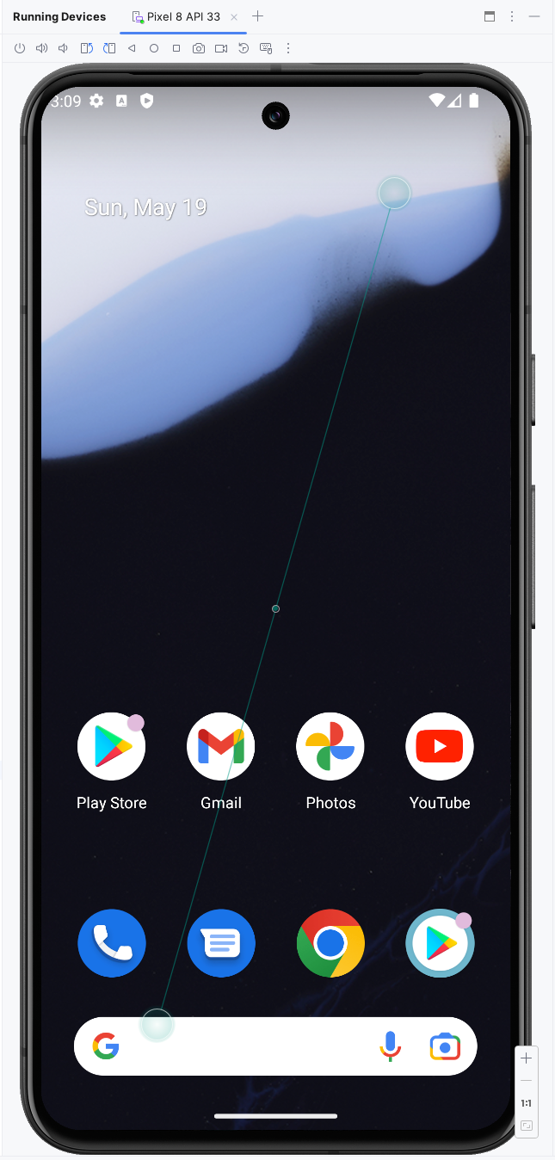
Launching an Emulator
To create an emulator:
Open Device Manager → Create Device
Choose a Pixel model (e.g., Pixel 8)
Select API 33+ (Android 13)
Set Internal Storage: 4GB
Note: Use Pixel 3a / API 30 for low-spec PCs.

Slide 24
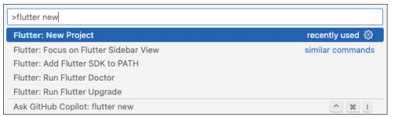
Using VS Code (Lightweight IDE)
Setup Steps
Install VS Code
Add Flutter & Dart extensions
Open a folder → Ctrl + Shift + P → Flutter: New Project
Run the app with F5 or terminal command flutter run
Notes:
Advantages
Fast startup & low memory usage
Easy extensions management
Integrated terminal

Slide 25
Your First Flutter App (“Hello World”)
Goal: Show how one simple Flutter program runs identically in all 3 development environments.
Run the App:
Environment | Steps
DartPad | Open dartpad.dev → New → Flutter → Paste code → ▶ Run
VS Code | Ctrl + Shift + P → Flutter: New Project → Replace lib/main.dart → flutter run or F5
Android Studio | New Flutter Project → Paste code → ▶ Run on emulator
Notes:
import 'package:flutter/material.dart';
void main() => runApp(const MaterialApp(
home: Scaffold(
body: Center(
child: Text('Hello, World ',
style: TextStyle(fontSize: 28, fontWeight: FontWeight.bold)),
),
),
));

Slide 26
Summary
Understand what Flutter is and how it evolved.
Describe the three-layer architecture: Framework → Engine → Embedder.
Recognize the benefits of Flutter vs other frameworks.
Understand Dart basics and its role in Flutter.
Set up the development environments: DartPad, VS Code, Android Studio.
Install Flutter SDK and verify setup using flutter doctor.
Create and run your first app – “Hello World” – on three platforms.

Slide 27
References
Mastering Flutter 2025 – Ch.1
docs.flutter.dev
https://dartpad.dev
dart.dev/guides
github.com/flutter/flutter

